Slide 1
C YOUR CODE TRIPLE

Slide 2
INTRODUCTION
The first component of a triple is the operation code, which specifies the type of operation to be performed, such as addition or subtraction. The second component is the source operand, which identifies the data to be operated on, such as a variable or a constant. The third component is the destination operand, which specifies where the result of the operation should be stored.
The triple data structure is useful because it can be used to represent complex expressions and instructions in a concise and structured way. For example, a complex expression like "a = b + c * d" can be represented as a series of triples that break down the expression into its constituent parts. This representation is easier for a compiler to analyse and optimize, which can lead to faster and more efficient code execution.
In addition to representing individual instructions, triples can also be used to represent control flow structures like loops and conditional statements. For example, a conditional statement like "if (x < y) { a = b + c; } else { a = b - c; }" can be represented using triples that encode the comparison, the branches, and the operations performed in each branch.

Slide 3
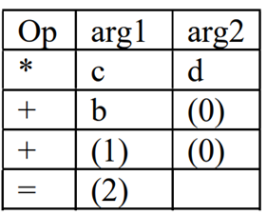

Slide 4
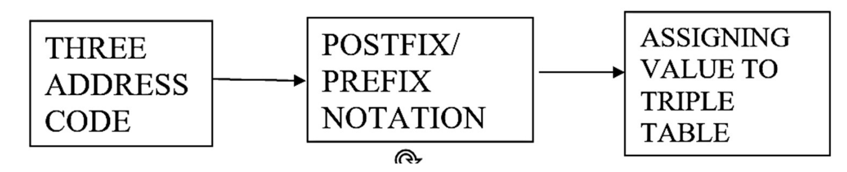
COMPONENT DIAGRAM

Slide 5
COMPONENT DIAGRAM
In a component diagram for a triple, the three components of the triple - the operation code, the source operand, and the destination operand - would be represented as separate components, connected by lines that indicate the relationships between them. For example, the operation code component would have a line connecting it to the source operand component, indicating that the operation code specifies the type of operation to be performed on the source operand.
In addition to the three components of the triple, a component diagram for a triple might also include other components that are used in the overall program, such as variables, constants, and control flow structures. These components would also be connected by lines to indicate their relationships.

